Slide 1
Migration: A World in Motion
A Multinational Conference on Migration and Migration Policy
Most Desired Migration Destinations and Antecedents of Migration Intent Across the World: Insights From Gallup World Poll
18-20 February 2010
University of Maastricht, Maastricht, Netherlands

Slide 2
Gallup World Poll
Annually polling 95% of the Earth's adult population
Conducted in more than 130 countries and territories
Nationally representative data - includes both urban and rural areas
Samples of at least 1,000 adults per country
  In countries where data is collected face-to-face – multi stage stratified cluster samples
  In countries where data is collected over telephone – RDD or list assisted RDD
Rigorous measurement methodology
  Translation and standardization of instrument
  Item construction and validation
Same core questions asked across nations and over time to facilitate trend analysis
Regional and local questions that provide contextual data
Topics: jobs, health, safety, standard of living, government and private institutions, environment, migration, and education
Copyright © 2007 Gallup, Inc. All rights reserved.

Slide 3
Gallup studies several aspects of migration, approaching the topic from multiple perspectives.
Future
  Residents’ desire to go abroad for temporary work and study, or to move away permanently
  Potential migrants’ preferred destination countries
  Residents’ active plans and preparations to move to another country
Present
  Labor migration flow for temporary workers (registered and unregistered)
  Destinations where household members are temporarily working or studying abroad
  Social networks abroad
  Remittances
  Attitudes toward migrants in destination countries
Copyright © 2007 Gallup, Inc. All rights reserved.

Slide 4
Desire to Migrate
Ideally, if you had the opportunity, would you like to move permanently to another country, or would you prefer to continue living in this country?
1 Like to move to another country
2 Like to continue living in this country
3 (Don’t Know)
4 (Refused)
The analysis of adults’ desire to move to another country permanently is based on 259,542 interviews aggregated across multiple surveys in 135 countries.
Copyright © 2007 Gallup, Inc. All rights reserved.

Slide 5
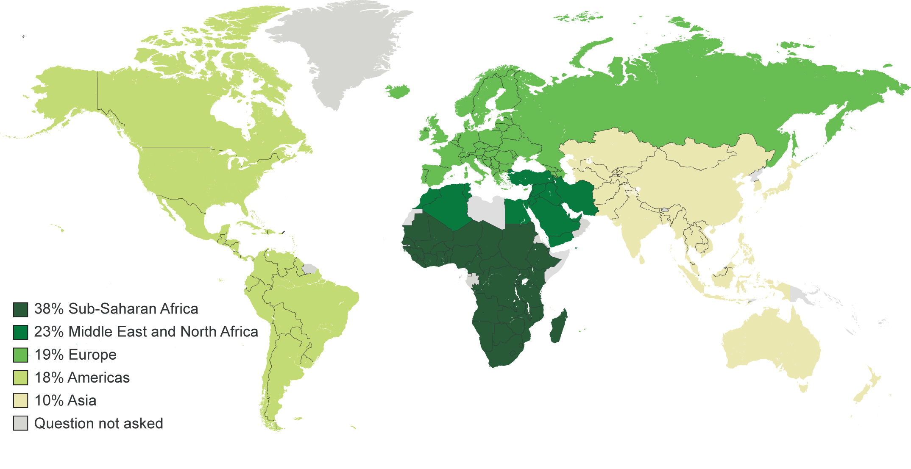
Approximately 700 million adults worldwide (16% of the global population) would like to move abroad permanently.
Copyright © 2010 Gallup, Inc. All rights reserved.

Slide 6
Key Findings Regarding Potential Permanent Migration:
Who Wants to Move, Where, and Why
About 16% of adults would like to move abroad permanently if given the opportunity
  80% of adults in developing countries who would like to move abroad would like to go to developed countries
  13% of potential migrants in developed countries would like to go to developing countries
In most countries, desire to relocate permanently did not decrease after the global economic crisis hit in 2008
The proportion of adults who want to migrate varies within and across regions and countries, as do motivations to migrate. Motivations can change over time.
Copyright © 2009 Gallup, Inc. All rights reserved.

Slide 7
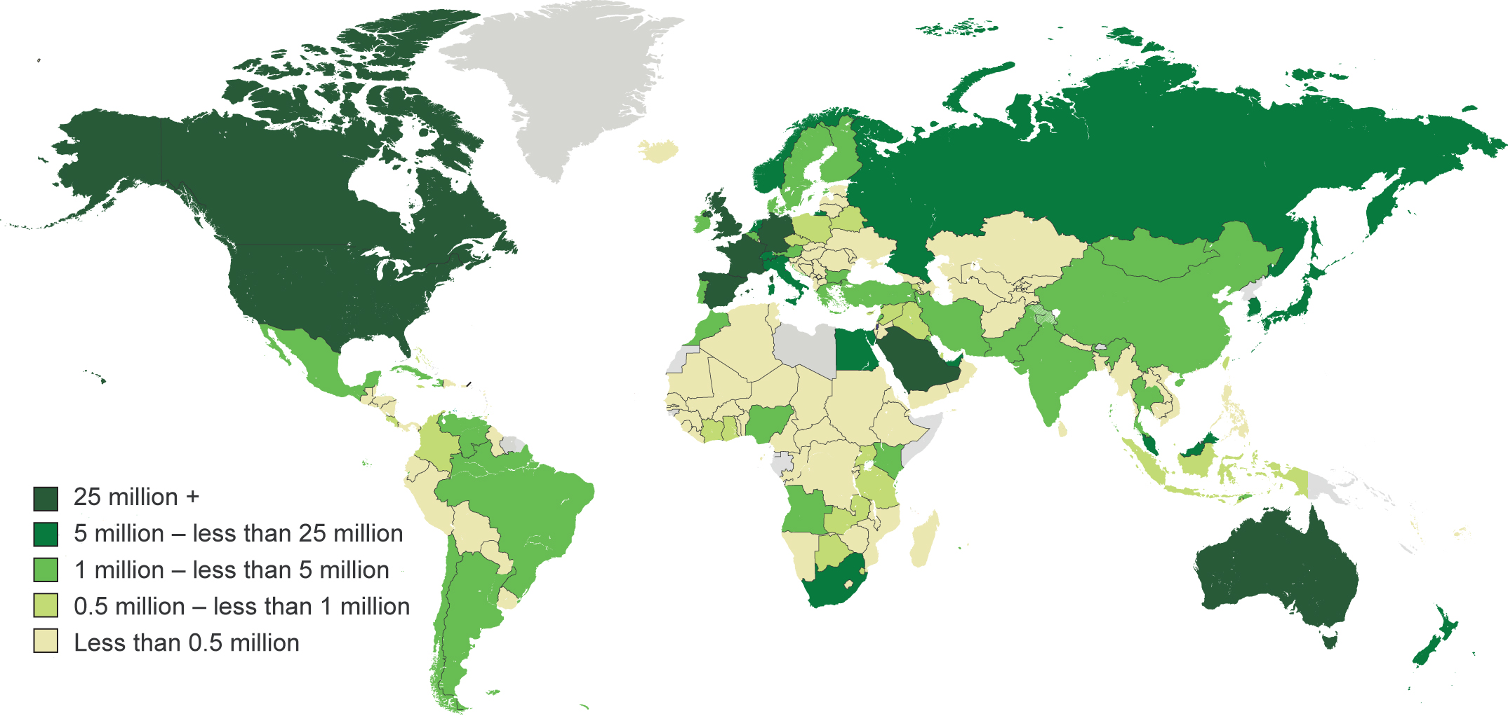
The most desired destination countries are the U.S., Canada, the U.K., France, Spain, Saudi Arabia, Germany, and Australia.
Copyright © 2009 Gallup, Inc. All rights reserved.

Slide 8
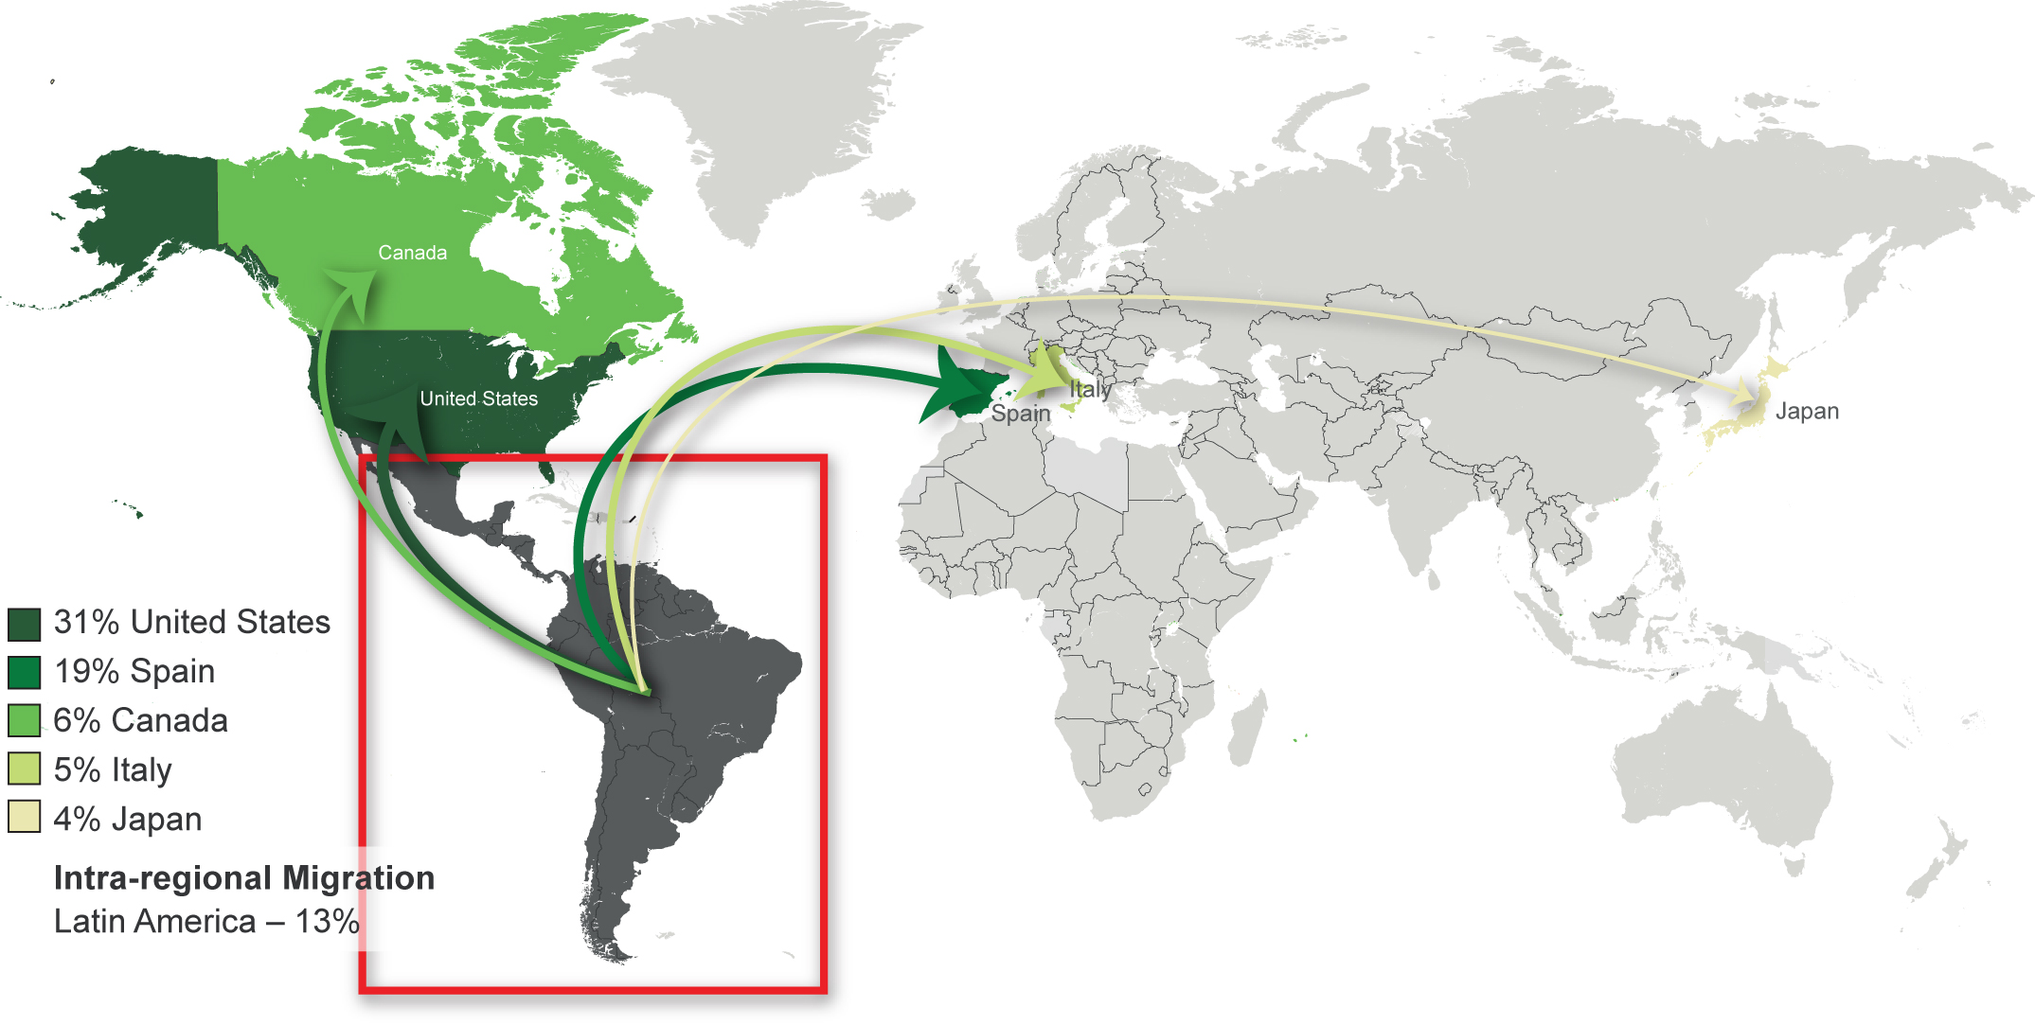
Adults in Latin America are most likely to say they would like to move permanently to the EU and Northern America.
Copyright © 2010 Gallup, Inc. All rights reserved.

Slide 9
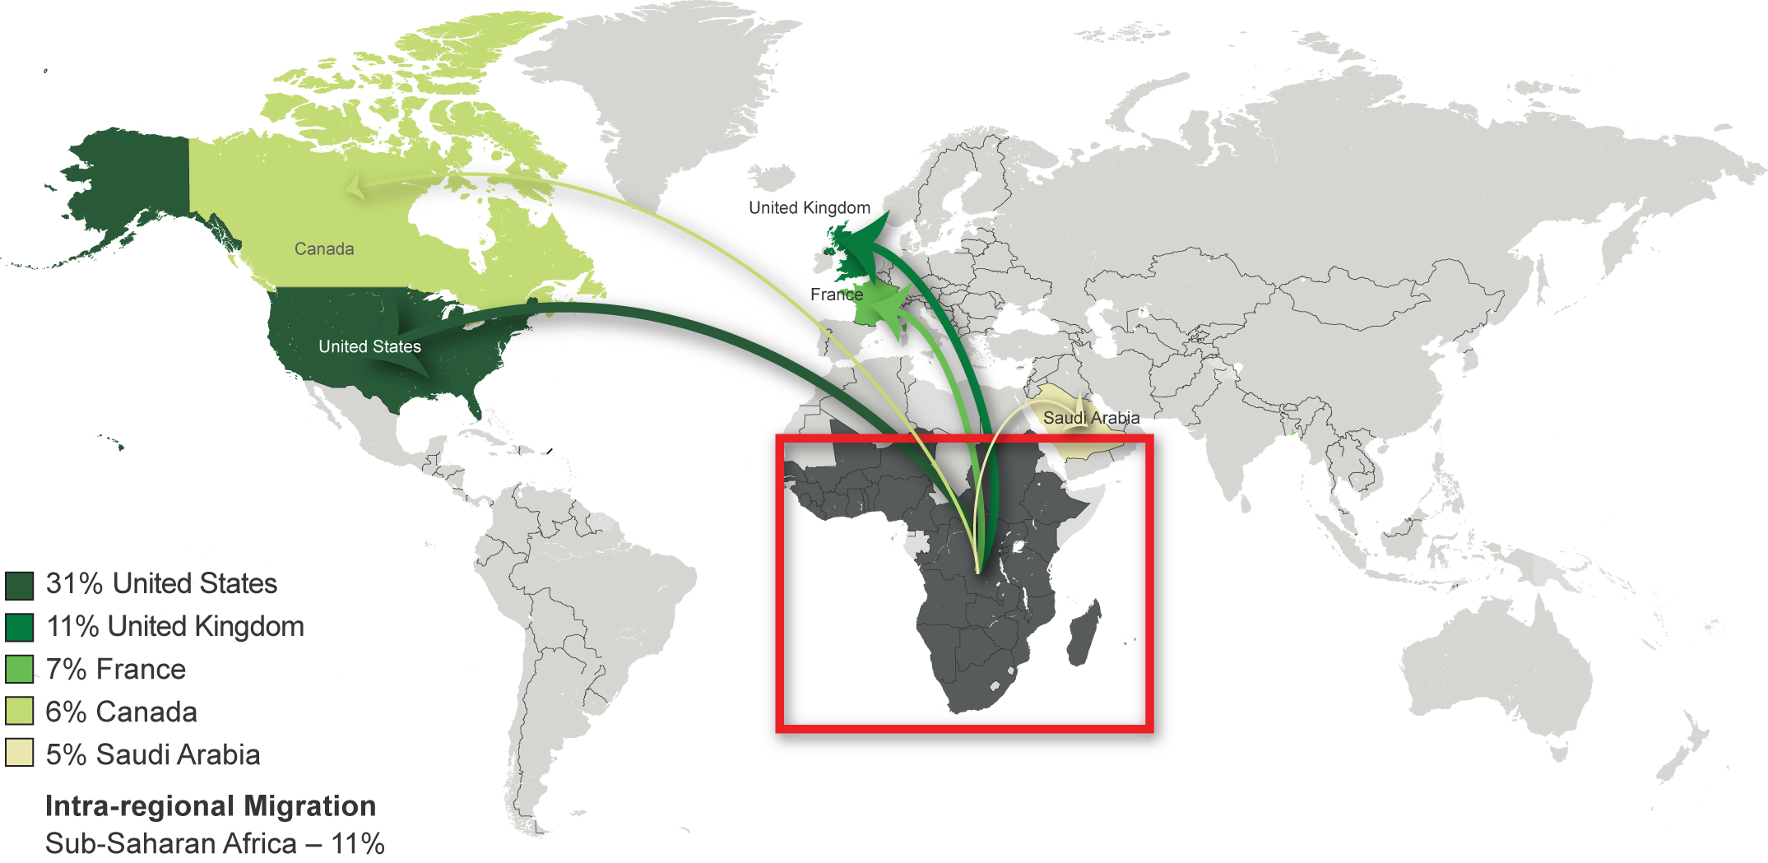
Adults in Sub-Saharan Africa are most likely to say they would like to move permanently to Northern America and the EU.
Copyright © 2010 Gallup, Inc. All rights reserved.

Slide 10
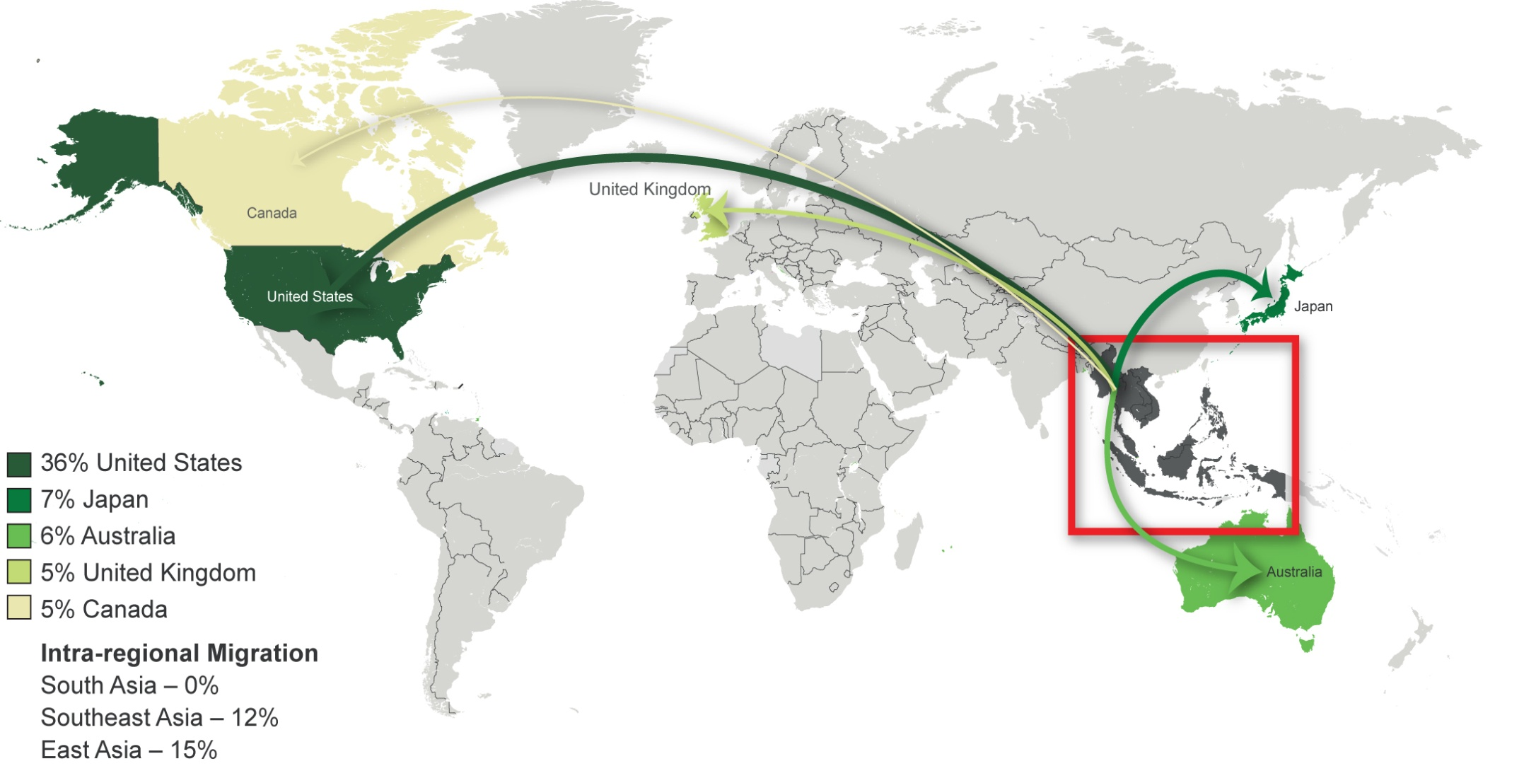
Adults in Southeast Asia are most likely to say they would like to move permanently to Northern America, followed by East Asia and the EU.
Copyright © 2010 Gallup, Inc. All rights reserved.

Slide 11
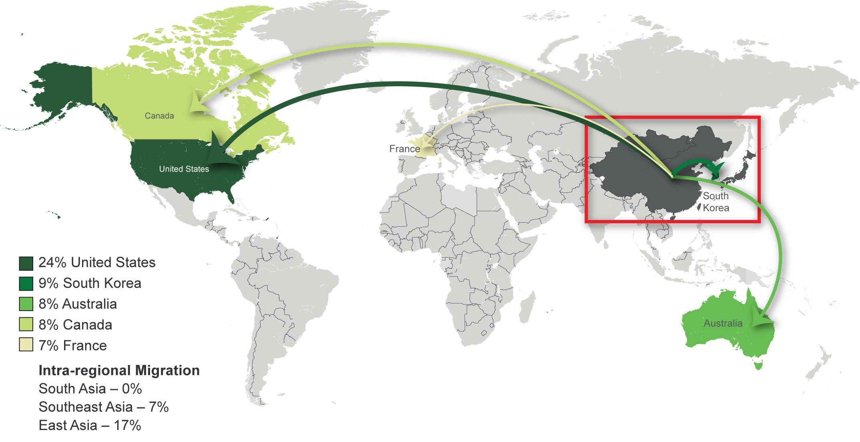
Adults in East Asia are most likely to say they would like to move permanently to Northern America and the EU.
Copyright © 2010 Gallup, Inc. All rights reserved.

Slide 12
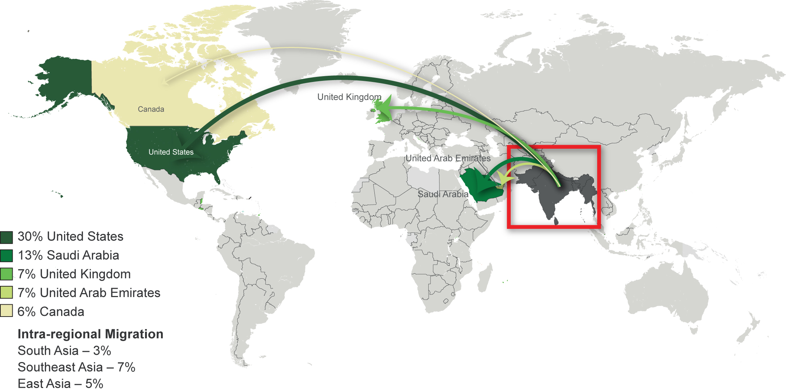
Adults in South Asia are most likely to say they would like to move permanently to Northern America and the Middle East.
Copyright © 2010 Gallup, Inc. All rights reserved.

Slide 13
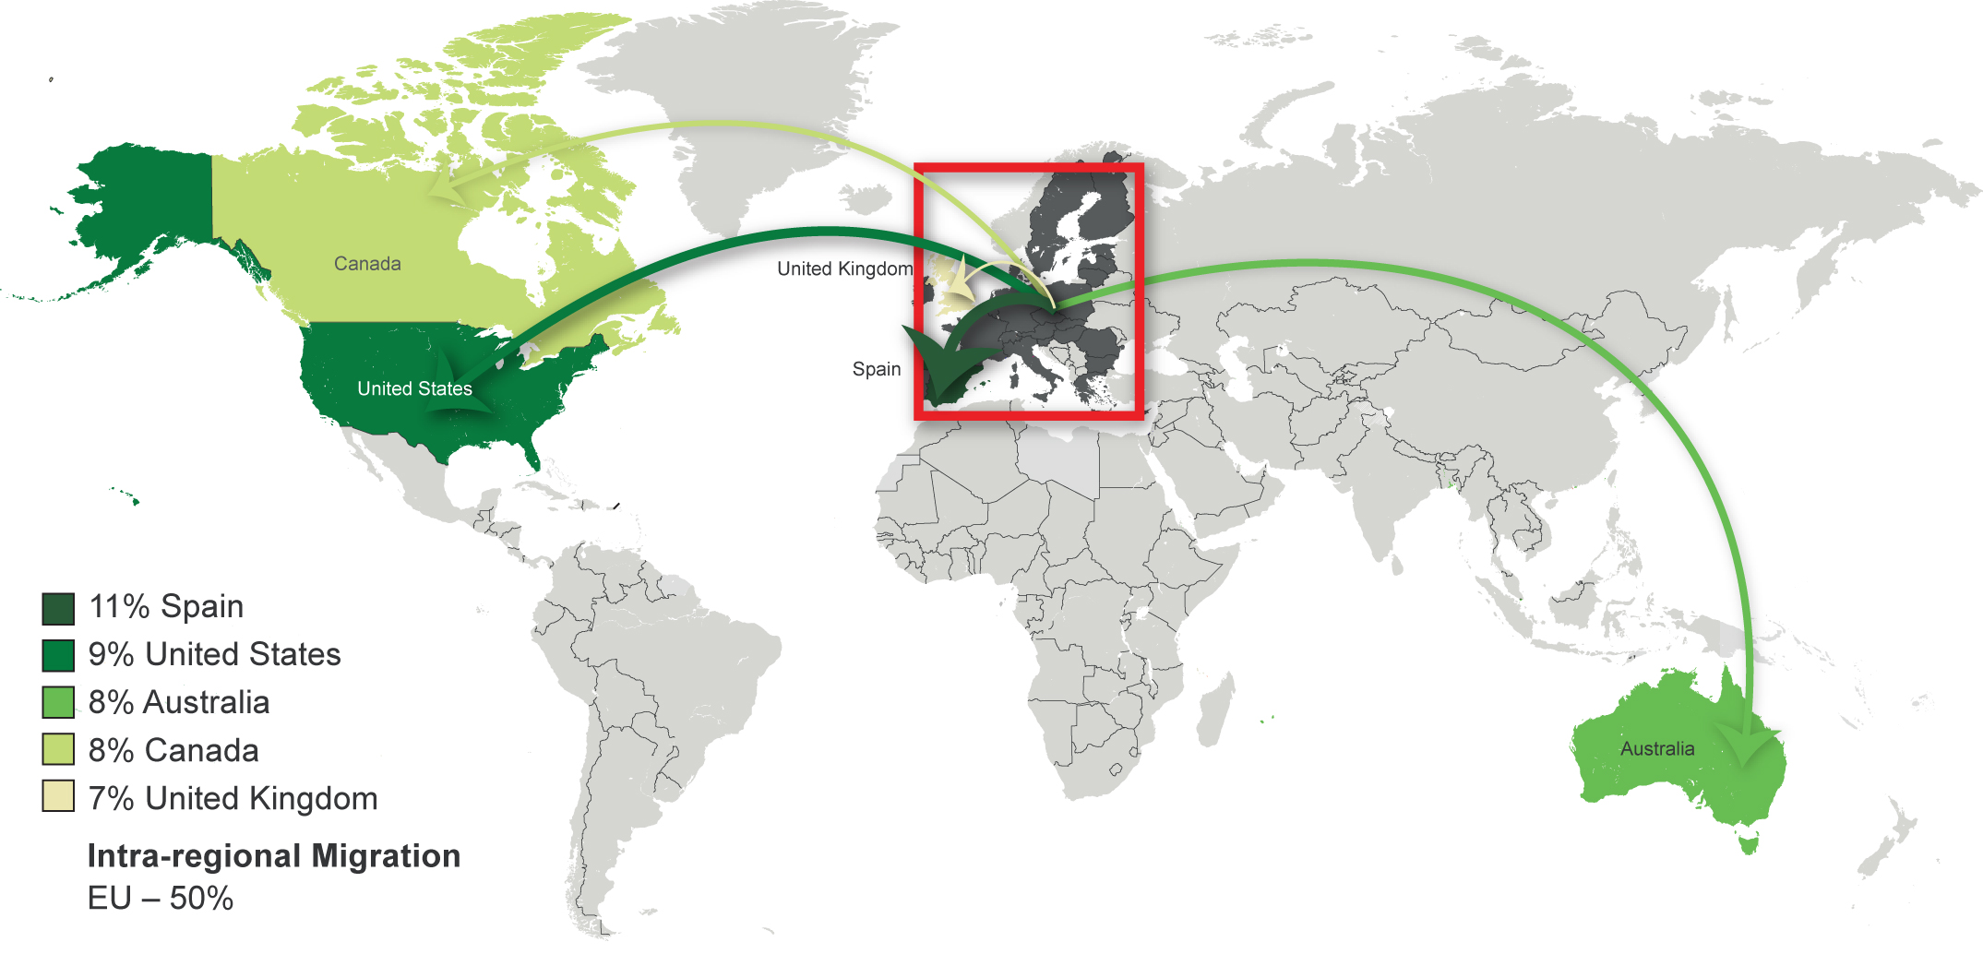
Adults in the EU are most likely to say they would like to move permanently to other countries within the EU, followed by Northern America.
Copyright © 2010 Gallup, Inc. All rights reserved.

Slide 14
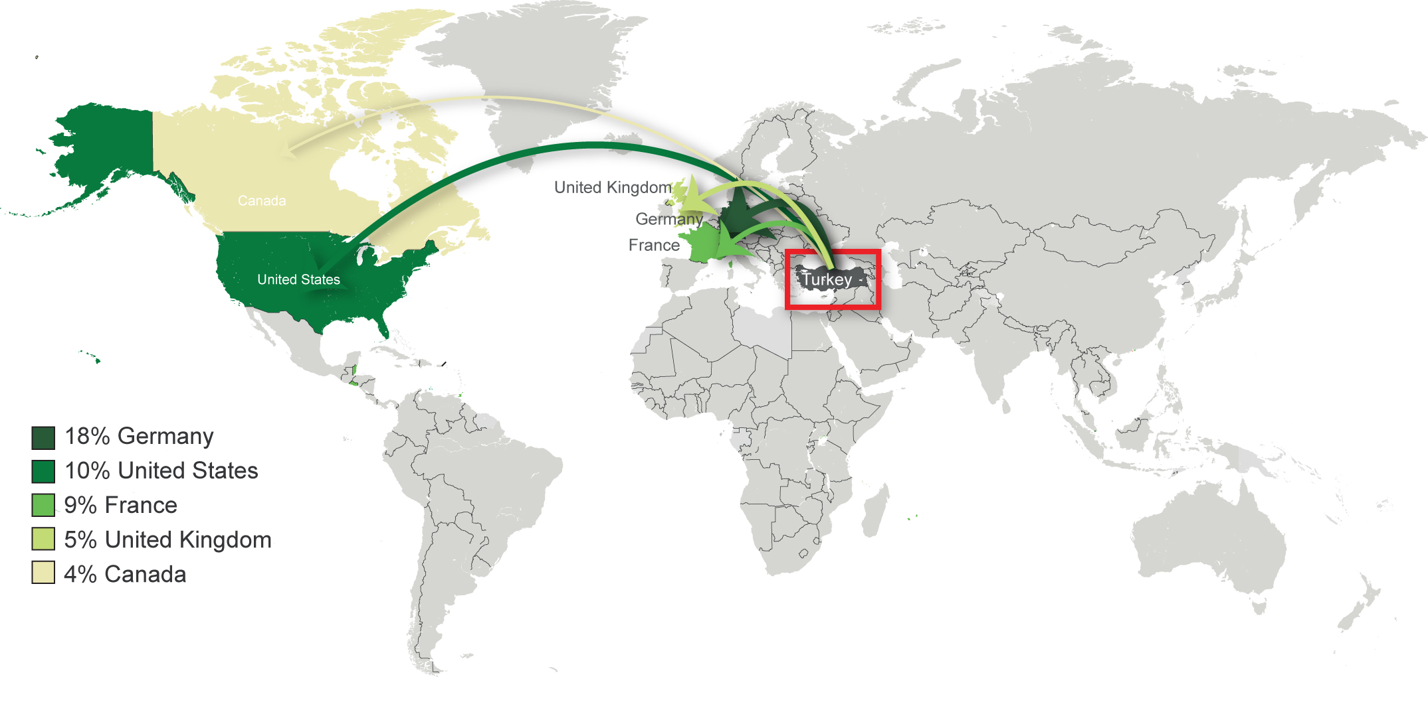
Approximately 6.6 million adults in Turkey want to move abroad permanently (13% of adult population).
Copyright © 2009 Gallup, Inc. All rights reserved.

Slide 15
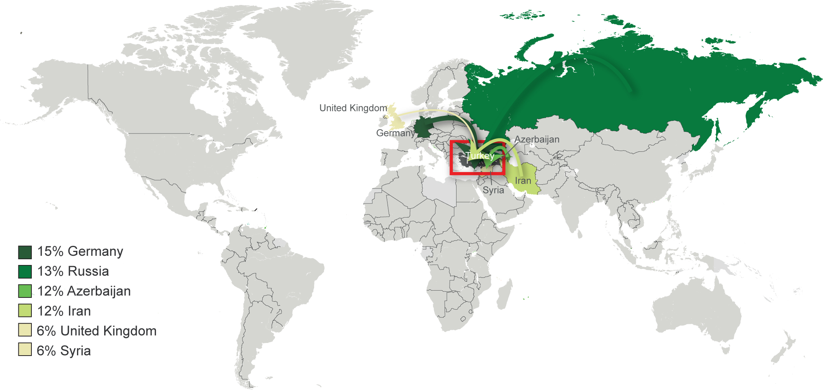
Approximately 1.9 million adults worldwide want to move permanently to Turkey.
Copyright © 2009 Gallup, Inc. All rights reserved.

Slide 16
Potential Net Migration Index (PNMI)
Calculated by subtracting the estimated number of adults who would like to move out of the country permanently from the estimated number of adults who would like to move in to that country, as proportion of the total adult population
 | and El Salvador (-50%). El
Lowest Scores:
  Congo Kinshasa (-60%),
  Zimbabwe (-55%)
  Sierra Leone (-55%)
  Haiti (-50%)
  El Salvador (-50%)
Highest Scores:
  Singapore (+260%)
  Qatar (+240%)*
  Saudi Arabia (+180%)*
  New Zealand (+175%)
  Canada (+170%)
  Australia (+145%)
  Sweden (+80%)
  *Note: In the Gulf Council Countries, only Arab nationals and Arab expatriates were surveyed.
Copyright © 2009 Gallup, Inc. All rights reserved.

Slide 17
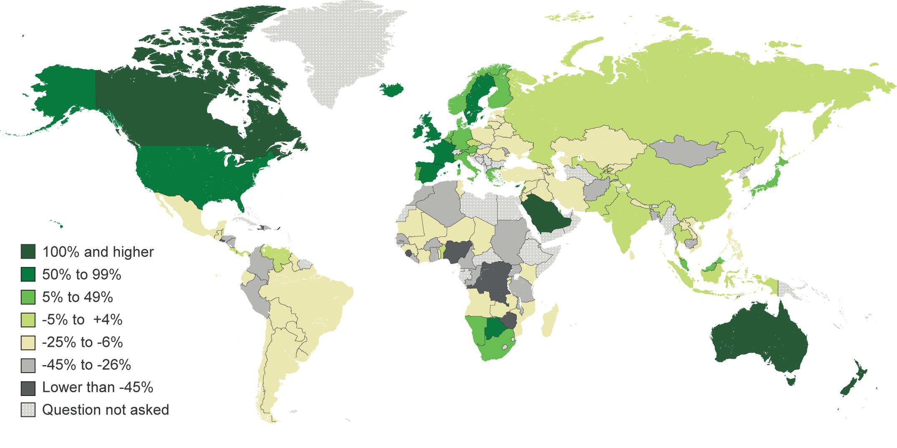
Gallup Potential Net Migration Index

Slide 18
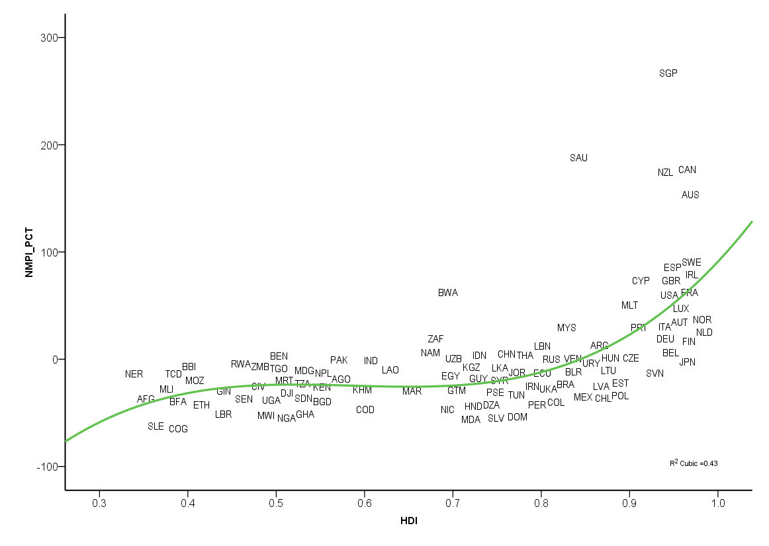
Human Development and Potential Net Migration
Gallup Potential Net Migration Index
R² cubic = 0.43
Human Development Index
Copyright © 2009 Gallup, Inc. All rights reserved.

Slide 19
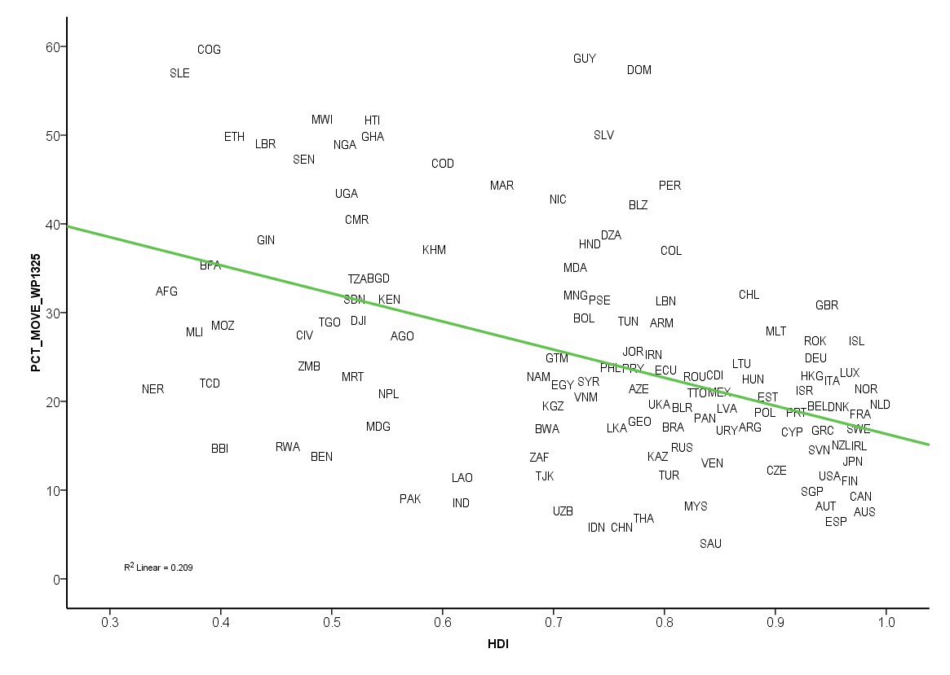
Human Development and Desire to Migrate
% Desire to Migrate
R² = 0.21
Human Development Index
Copyright © 2009 Gallup, Inc. All rights reserved.

Slide 20
Human Development and Potential Net Migration
HDI 4
HDI 3b
HDI 3a
HDI 2
HDI 1
Gallup Potential Net Migration Index
R² cubic = 0.43
Human Development Index
Copyright © 2009 Gallup, Inc. All rights reserved.

Slide 21
Human Development and Desire to Migrate
HDI 4
HDI 3b
HDI 3a
HDI 2
HDI 1
% Desire to Migrate
R² = 0.21
Human Development Index
Copyright © 2009 Gallup, Inc. All rights reserved.

Slide 22
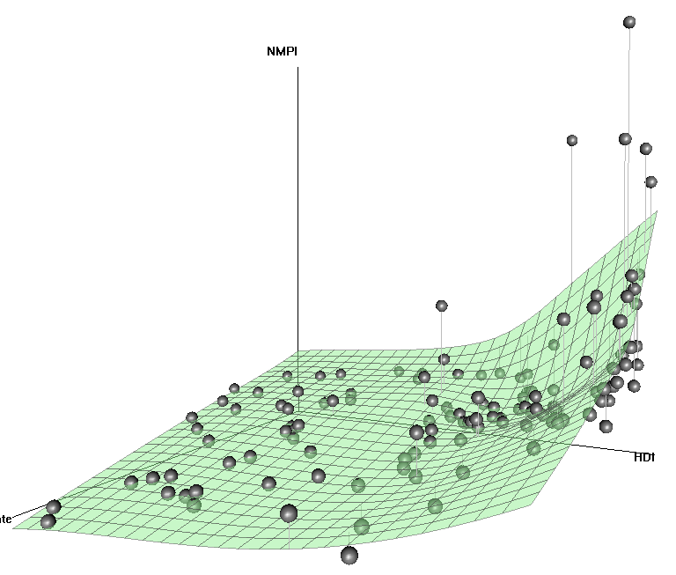
Human Development, Potential Net Migration, and
Desire to Migrate
Gallup Potential Net Migration Index
Human Development
Index
Desire to Migrate
(% 15+ pop.)
Copyright © 2009 Gallup, Inc. All rights reserved.

Slide 23
Desire to Migrate: Statistical Analysis
Data for 103 countries collected in 2008–2009 were analyzed in
5 different groups according to HDI level (13-29 countries per group).
Country-level data are weighted by household size (probability of selection), age, sex and education. Countries are then proportionalized within each HDI level according to 15+ population.
Binary logistic regression was conducted using sas proc surveylogistic (to account for survey stratification and clustering in the calculation of standard errors).
Copyright © 2009 Gallup, Inc. All rights reserved.

Slide 24
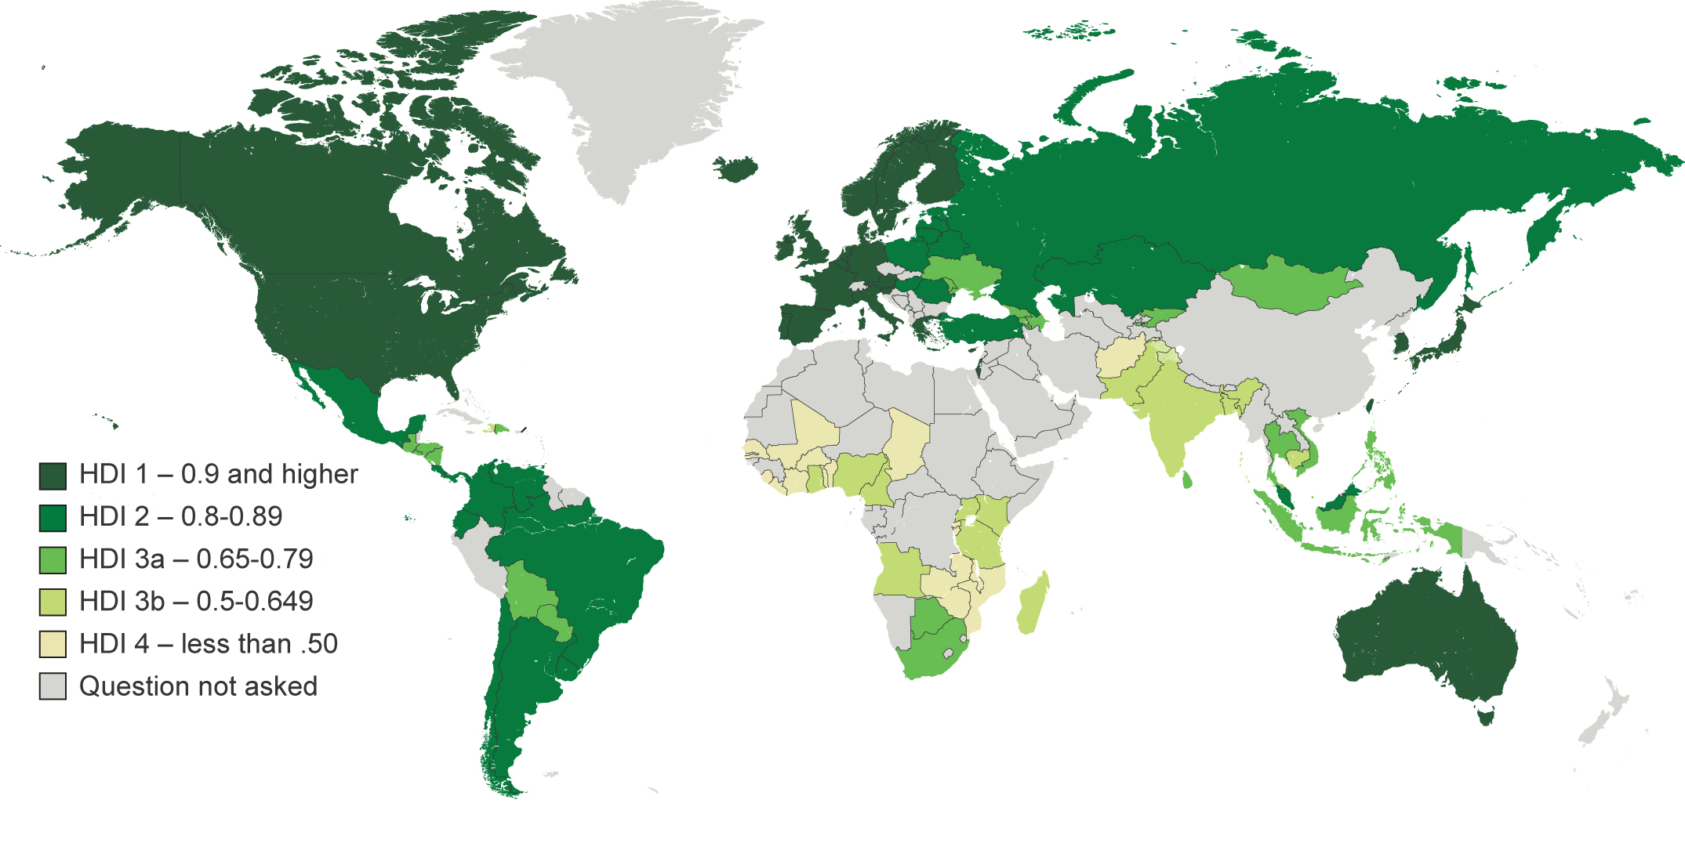
Countries Included in Analysis by Groups
Note: countries where core World Poll questionnaire survey items were not asked (due to government restrictions) were excluded from the analysis – e.g., China, Jordan, Kuwait, Saudi Arabia, Sudan, Syria, Turkmenistan, Yemen.
Copyright © 2009 Gallup, Inc. All rights reserved.

Slide 25
Desire to Migrate: Statistical Analysis
Independent variables included in the regression modeling:
  Demographics: sex, age (15-34), education, marital status (married)
  Region of world
  National institutions
  Local environment
  Treatment of children in country
  Corruption (government, business)
  Entrepreneurship
  Transnational social networks
Copyright © 2009 Gallup, Inc. All rights reserved.

Slide 26
Predictors of Desire to Migrate: Global Key Findings
Youth effect: regardless of HDI level, age (15-34) is a predictor of desire to migrate.
Marriage effect: being married is a negative predictor of desire to migrate.
Education: those with a secondary or tertiary education are more likely to want to migrate than those with less than a secondary education.
Copyright © 2009 Gallup, Inc. All rights reserved.

Slide 27
Predictors of Desire to Migrate: Global Key Findings
Social networks: having relatives or friends living in another country on whom one can rely on for help, or having a working-age member of one’s household living in another country are predictors of desire to migrate.
Location, location: dissatisfaction with one’s city or the area where one lives is a predictor of desire to migrate.
Copyright © 2009 Gallup, Inc. All rights reserved.

Slide 28
Predictors of Desire to Migrate: HDI Level-Specific Findings
Expressing a lack of confidence in police (HDI 1, 2, 3a, 4)
Indicating that most people in one’s country are afraid to openly express their political views (HDI 1, 2, 3a, 3b)
Indicating that children are not respected in one’s country (HDI 1, 2, 3a, 4)
Copyright © 2009 Gallup, Inc. All rights reserved.

Slide 29
Predictors of Desire to Migrate: HDI Level-Specific Findings
HDI 1: Indicating that corruption is widespread in business in one’s country is a predictor of desire to migrate.
HDI 2: The effect of having family members abroad, or of having family members who have gone abroad and returned, is stronger than in other HDI levels.
HDI 3a: Economic factors (indicating that economic conditions are poor, the national economy is poor, or that it is a bad time to find a job in one’s country) are not significant predictors of desire to migrate.
Copyright © 2009 Gallup, Inc. All rights reserved.

Slide 30
Predictors of Desire to Migrate: HDI Level-Specific Findings
HDI 3b: Only secondary education attainment is a significant predictor of desire to migrate (those with a secondary education are more likely to desire to migrate than those with less than a secondary education or a tertiary education).
HDI 4: Political factors (indicating that corruption is widespread in government, expressing disapproval of one’s country’s leadership, and indicating that most people in one’s country are afraid to express their political views) are not significant predictors of desire to migrate.
Copyright © 2009 Gallup, Inc. All rights reserved.

Slide 31
Gallup Potential Net Migration Index

Slide 32
Logistic Regression: HDI 1
 | b | SE | OR | Sig.
Intercept | -3.83 | 0.20 | 0.02 | ***
Sex (male) | 0.16 | 0.08 | 1.17 | n.s.
Age (15 to 34) | 0.54 | 0.09 | 1.71 | ***
Education
Secondary | 0.24 | 0.12 | 1.27 | *
Tertiary | 0.51 | 0.13 | 1.66 | ***
Marital status (married) | -0.30 | 0.08 | 0.74 | ***
Region
Northern Europe | 1.03 | 0.14 | 2.80 | ***
Western & Central Europe | 0.78 | 0.12 | 2.18 | ***
Southern Europe | 0.23 | 0.13 | 1.26 | n.s.
Asia-Pacific | 0.66 | 0.12 | 1.94 | ***
Dissatisfied with city/area | 0.68 | 0.11 | 1.98 | ***
No confidence in local police | 0.50 | 0.09 | 1.64 | ***
Children are not treated with respect | 0.29 | 0.09 | 1.34 | **
Corruption widespread in government | 0.24 | 0.11 | 1.28 | *
Disapprove of country's leadership | 0.34 | 0.09 | 1.40 | ***
Most people afraid to express political views | 0.31 | 0.12 | 1.36 | *
Economic conditions in country are poor | 0.28 | 0.08 | 1.33 | ***
Economic conditions in country getting worse | 0.15 | 0.09 | 1.16 | n.s.
Bad time to find job in city/area | -0.05 | 0.10 | 0.95 | n.s.
Corruption widespread in business | 0.30 | 0.10 | 1.35 | **
Planning to start your business | 0.04 | 0.17 | 1.04 | n.s.
Can count on help from relatives/friends in another country | 0.67 | 0.09 | 1.94 | ***
Members of household gone to live in another country
Yes – still there | 0.45 | 0.15 | 1.94 | ***
Yes – returned | 0.51 | 0.16 | 1.56 | **
n | 25806
Cox & Snell R² | 0.11
Nagelkerke R² | 0.19
Likelihood Ratio R² | 0.12
Copyright © 2009 Gallup, Inc. All rights reserved.

Slide 33
Logistic Regression: HDI 2
 | b | SE | OR | Sig.
Intercept | -3.89 | 0.20 | 0.02 | ***
Sex (male) | 0.31 | 0.07 | 1.37 | ***
Age (15 to 34) | 0.86 | 0.07 | 2.37 | ***
Education
Secondary | 0.21 | 0.09 | 1.24 | *
Tertiary | 0.27 | 0.12 | 1.30 | *
Marital status (married) | -0.33 | 0.08 | 0.72 | ***
Region
Eastern Europe | 0.59 | 0.16 | 1.81 | ***
Baltic Countries | 0.84 | 0.16 | 2.31 | ***
Former Soviet Union (other than Baltic) | 0.45 | 0.14 | 1.56 | **
Latin American & Caribbean | 0.18 | 0.15 | 1.20 | n.s.
Dissatisfied with city/area | 0.56 | 0.08 | 1.75 | ***
No confidence in local police | 0.51 | 0.08 | 1.67 | ***
Children are not treated with respect | 0.26 | 0.08 | 1.30 | ***
Corruption widespread in government | -0.13 | 0.11 | 0.88 | n.s.
Disapprove of country's leadership | 0.16 | 0.08 | 1.17 | *
Most people afraid to express political views | 0.38 | 0.09 | 1.46 | ***
Economic conditions in country are poor | 0.21 | 0.08 | 1.24 | *
Economic conditions in country getting worse | 0.14 | 0.08 | 1.16 | n.s.
Bad time to find job in city/area | -0.02 | 0.08 | 0.98 | n.s.
Corruption widespread in business | 0.19 | 0.10 | 1.21 | n.s.
Planning to start your business | 0.30 | 0.12 | 1.35 | *
Can count on help from relatives/friends in another country | 0.80 | 0.08 | 2.23 | ***
Members of household gone to live in another country
Yes – still there | 0.94 | 0.12 | 2.23 | ***
Yes – returned | 0.69 | 0.14 | 2.56 | ***
n | 21424
Cox & Snell R² | 0.12
Nagelkerke R² | 0.21
Likelihood Ratio R² | 0.15
Copyright © 2009 Gallup, Inc. All rights reserved.

Slide 34
Logistic Regression: HDI 3a
 | b | SE | OR | Sig.
Intercept | -3.12 | 0.14 | 0.04 | ***
Sex (male) | 0.14 | 0.09 | 1.15 | n.s.
Age (15 to 34) | 0.73 | 0.08 | 2.09 | ***
Education
Secondary | 0.25 | 0.11 | 1.28 | *
Tertiary | 0.42 | 0.12 | 1.52 | ***
Marital status (married) | -0.52 | 0.09 | 0.60 | ***
Region
Southern Africa | 0.14 | 0.16 | 1.15 | n.s.
Former Soviet Union | 0.35 | 0.13 | 1.42 | **
Latin American & Caribbean | 0.68 | 0.10 | 1.98 | ***
Dissatisfied with city/area | 0.70 | 0.11 | 2.02 | ***
No confidence in local police | 0.23 | 0.09 | 1.26 | *
Children are not treated with respect | 0.35 | 0.10 | 1.41 | ***
Corruption widespread in government | -0.22 | 0.12 | 0.80 | n.s.
Disapprove of country's leadership | 0.17 | 0.09 | 1.19 | n.s.
Most people afraid to express political views | 0.23 | 0.10 | 1.25 | *
Economic conditions in country are poor | -0.03 | 0.09 | 0.97 | n.s.
Economic conditions in country getting worse | 0.13 | 0.10 | 1.14 | n.s.
Bad time to find job in city/area | -0.09 | 0.09 | 0.91 | n.s.
Corruption widespread in business | 0.17 | 0.11 | 1.19 | n.s.
Planning to start your business | 0.03 | 0.11 | 1.04 | n.s.
Can count on help from relatives/friends in another country | 0.89 | 0.10 | 2.44 | ***
Members of household gone to live in another country
Yes – still there | 0.50 | 0.11 | 2.44 | ***
Yes – returned | 0.40 | 0.18 | 1.64 | ***
n | 21303
Cox & Snell R² | 0.11
Nagelkerke R² | 0.21
Likelihood Ratio R² | 0.16
Copyright © 2009 Gallup, Inc. All rights reserved.

Slide 35
Logistic Regression: HDI 3b
 | b | SE | OR | Sig.
Intercept | -3.52 | 0.20 | 0.03 | ***
Sex (male) | 0.34 | 0.13 | 1.41 | **
Age (15 to 34) | 0.51 | 0.13 | 1.66 | ***
Education
Secondary | 0.83 | 0.12 | 2.30 | ***
Tertiary | 0.33 | 0.29 | 1.39 | n.s.
Marital status (married) | -0.48 | 0.14 | 0.62 | ***
Region
Southern Africa | 0.07 | 0.18 | 1.07
Eastern Africa | 0.70 | 0.10 | 2.02 | ***
Latin American & Caribbean | 0.97 | 0.23 | 2.63 | ***
Dissatisfied with city/area | 0.45 | 0.12 | 1.57 | ***
No confidence in local police | 0.25 | 0.13 | 1.29 | n.s.
Children are not treated with respect | 0.05 | 0.12 | 1.05 | n.s.
Corruption widespread in government | 0.10 | 0.22 | 1.11 | n.s.
Disapprove of country's leadership | -0.22 | 0.19 | 0.80 | n.s.
Most people afraid to express political views | 0.68 | 0.14 | 1.97 | ***
Economic conditions in country are poor | -0.01 | 0.15 | 0.99 | n.s.
Economic conditions in country getting worse | 0.30 | 0.16 | 1.35 | n.s.
Bad time to find job in city/area | 0.34 | 0.14 | 1.40 | *
Corruption widespread in business | 0.35 | 0.22 | 1.41 | n.s.
Planning to start your business | 0.61 | 0.12 | 1.84 | ***
Can count on help from relatives/friends in another country | 0.38 | 0.14 | 1.46 | **
Members of household gone to live in another country
Yes – still there | 0.82 | 0.16 | 1.46 | **
Yes – returned | 0.47 | 0.22 | 2.27 | ***
n | 13647
Cox & Snell R² | 0.12
Nagelkerke R² | 0.22
Likelihood Ratio R² | 0.19
Copyright © 2009 Gallup, Inc. All rights reserved.

Slide 36
Logistic Regression: HDI 4
 | b | SE | OR | Sig.
Intercept | -2.77 | 0.13 | 0.06 | ***
Sex (male) | 0.13 | 0.06 | 1.14 | *
Age (15 to 34) | 0.77 | 0.07 | 2.17 | ***
Education
Secondary | 0.50 | 0.08 | 1.65 | ***
Tertiary | 0.21 | 0.19 | 1.23
Marital status (married) | -0.28 | 0.06 | 0.76 | ***
Region
Southern Africa | 0.22 | 0.08 | 1.25 | **
Ethiopia | 0.53 | 0.13 | 1.70 | ***
Afghanistan | 0.68 | 0.12 | 1.98 | ***
Dissatisfied with city/area | 0.52 | 0.07 | 1.69 | ***
No confidence in local police | 0.23 | 0.07 | 1.25 | **
Children are not treated with respect | 0.34 | 0.07 | 1.41 | ***
Corruption widespread in government | 0.17 | 0.11 | 1.18
Disapprove of country's leadership | 0.02 | 0.08 | 1.02
Most people afraid to express political views | -0.05 | 0.08 | 0.96
Economic conditions in country are poor | 0.11 | 0.07 | 1.11
Economic conditions in country getting worse | 0.28 | 0.08 | 1.33 | ***
Bad time to find job in city/area | 0.19 | 0.07 | 1.20 | *
Corruption widespread in business | 0.03 | 0.11 | 1.03
Planning to start your business | 0.20 | 0.06 | 1.22 | **
Can count on help from relatives/friends in another country | 0.19 | 0.09 | 1.21 | *
Members of household gone to live in another country
Yes – still there | 0.49 | 0.09 | 1.21 | *
Yes – returned | 0.23 | 0.13 | 1.63 | ***
n | 18200
Cox & Snell R² | 0.16
Nagelkerke R² | 0.22
Likelihood Ratio R² | 0.13
Copyright © 2009 Gallup, Inc. All rights reserved.

Slide 37
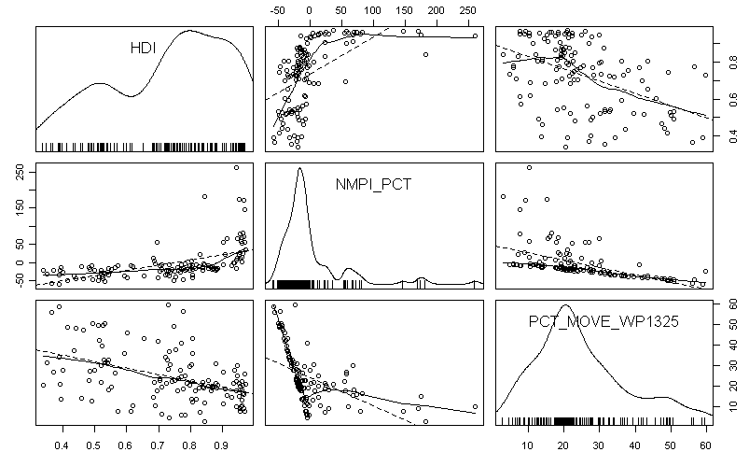
Human Development, Potential Net Migration, and
Desire to Migrate
Copyright © 2009 Gallup, Inc. All rights reserved.

Slide 38
Russia: Attitude Toward Immigrants
Question: In your view, should immigration in Russia be kept at its present level, increased, or decreased?
Copyright © 2010 Gallup, Inc. All rights reserved.

Slide 39
“Good government obtains
when those who are near are made happy, and those who are far off attracted to come.”
- Confucius

Slide 40
Russia: Immigrants and Jobs
Question: Do you think immigrants 1) Mostly take jobs that citizens in Russia do not want (e.g., low-paying or not prestigious), or 2) Mostly take jobs that other citizens in Russia could take?
Copyright © 2010 Gallup, Inc. All rights reserved.

Slide 41
Impact of the Economic Crisis on Migrant Workers
% Work in Another Country
-8%
-10%
-5%
-7%
Question: Does anyone in this household work temporarily in another country, or does everyone work in this country?
Copyright © 2010 Gallup, Inc. All rights reserved.
Notes:
\

Slide 42
Central Asia: Gap between where people want to go for temporary work and where they actually go – reality do not match desires.
Reality
Desire
Middle East & North Africa
3%
North
America
16%
Copyright © 2009 Gallup, Inc. All rights reserved.
Notes:
14

Slide 43
US: Attitude Toward Immigrants
Question: In your view, should immigration be kept at its present level, increased, or decreased?
Copyright © 2010 Gallup, Inc. All rights reserved.

Slide 44
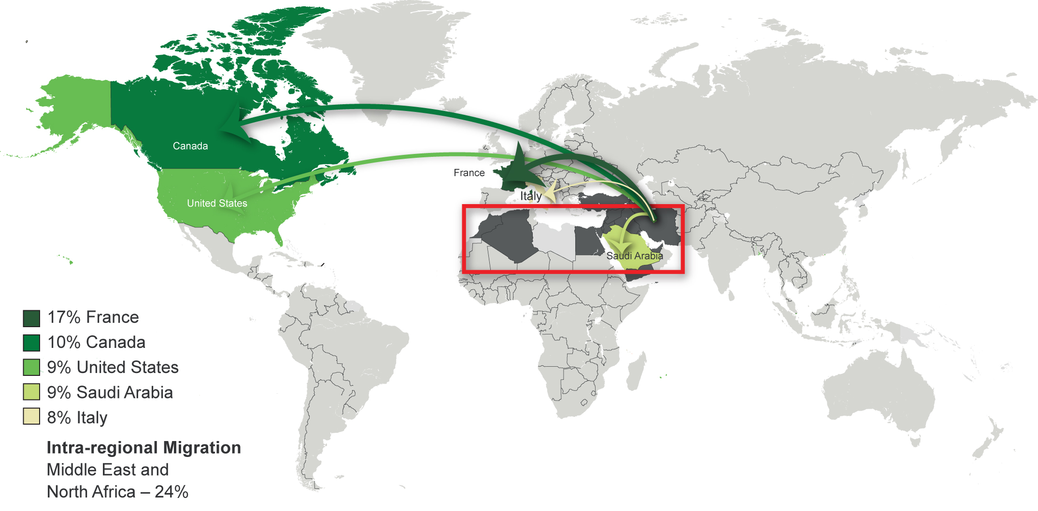
Those in the Middle East and North Africa most often want to move to France, Canada, the U.S., Saudi Arabia, and Italy.
Copyright © 2009 Gallup, Inc. All rights reserved.

Slide 45
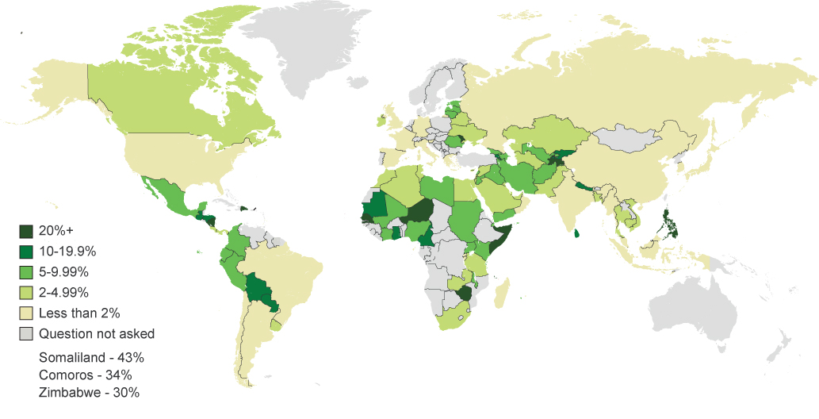
Dependence on remittance
Copyright © 2010 Gallup, Inc. All rights reserved.

